Slide 1

SonarQube
A Static Code Analysis Tool
Software Testing / Assignment A1
Time: March 25, 2021
Group 11
1853316 杜 玫
1854139 周子怡
1852448 李源峰

Slide 2
CONTENT
01
BACKGROUND
02
OBJECTIVE
Where and how does SonarQube come from？
What was SonarQube designed for?
03
FEATURES
04
USAGE
What are the features of SonarQube?
How to use sonarqube?
05
FUNCTIONALITIES
06
EXPERIMENTS
Your teammate for Code Quality and Code Security
Our Trials

Slide 3
1
Background
Where and how does SonarQube come from？
Notes:
Firstly, let’s see where and how does SonarQube come from?

Slide 4




Why we use SonarQube
In the traditional method, developers conduct code quality audits before releasing a new version. This method may be effective in the short term, especially with strong management support, but it always fails in the medium to long term because:
In this process, the code review came too late, and no stakeholders were keen to solve the problem; everyone hopes that the new version could be released;
Developers usually tend to reject a proposal made by an external team who does not know the background of the project;
This approach makes the code quality lack of ownership. Who is the owner of quality? nobody.
Before deploying to the production environment, the entire application is reviewed, and it is obviously impossible to apply the same standard to all applications. Each project will negotiate quality standards, which will reduce the credibility of code quality audits.
Notes:
Why do we need sonarqube and why we use it?
In the traditional method, developers conduct code quality audits before releasing a new version. This method may be effective in the short term, especially with strong management support, but it always fails in the medium to long term because:
First, everyone hopes to release a new version at that time so the code view came too late;
Second, if the test result was made by someone who does not know the background of the project, the developers may reject it.
Then, this will makes the code quality lack of ownership.
Lastly, it will be difficult to apply the same standard to all applications which will reduce the credibility of the code quality audits.
So ,we need a static code analysis tool to help us analyze the potential bug during the development. That is SonarQube.

Slide 5
About SonarQube
Code Quality and Security
27 programming languages
Code Reviews
clear remediation guidance
pairing-up with your existing software pipeline
understand and fix issues
100,000 organizations
Continuous integration engines
Jenkins, Azure DevOps, TeamCity, Bamboo,…
Source configuration management to0l
Git, Subversion, CVS, Mercurial, …
Built-n integration
no configuration approach
Notes:
Then let’s see what is sonarqube?
SonarQube is the leading tool for continuously inspecting the Code Quality and Security(点击) of your codebases and guiding development teams during Code Reviews(点击). Covering 27 programming languages(点击), while pairing-up with your existing software pipeline(点击), SonarQube provides clear remediation guidance(点击) for developers to understand and fix(点击) issues and for teams overall to deliver better, safer software. With over 170,000 deployments, helping small development teams as well as global organizations, SonarQube provides the means for all teams and companies, around the world, to own and impact their Code Quality and Security. Today SonarQube is used by more than 100,000(点击) organizations。
And also,Fully integrated with DevOps tool chains it comes with:
First，(点击)built-in integration with most build tools, which enables in most cases a no configuration approach
second，（点击）easy integration with continuous integration engines such as Jenkins, Azure DevOps, TeamCity, Bamboo,…
Thirdly，（点击）support for numerous source configuration management tools such as Git, Subversion, CVS, Mercurial, …

Slide 6
2
Objective
What was SonarQube designed for?
Notes:
Then the second part comes to the objective. That is about what was SonarQube designed for?

Slide 7
Objective
“Continuous Inspection must become mainstream as Continuous Integration”.
Continuously inspecting the Code Quality and Security
of our codebases and guiding development teams
during Code Reviews.
Notes:
Back in 2007, when first lines of code were created, the founders of SonarQube (originally called Sonar) had a dream to one day provide every developer the ability to measure the code quality of his projects. Their motto: “Continuous Inspection must become mainstream as Continuous Integration”.
（点击）
The main objective of sonarqube is continuously inspecting the Code Quality and Security of our codebases and guiding development teams during Code Reviews.
From what aspects can we maintain our code?

Slide 8
Sonar can detect code quality from the following seven dimensions
Objective
Sonar can use PMD, CheckStyle, Findbugs and other code rule detection tools to standardize code writing.
Not following the code standard
Potential defects
Poor complexity distribution
Duplicate
Insufficient or excessive comments
Lack of unit testing
Bad design
Files, classes, methods, etc., if the complexity is too high, it will be difficult to understand and change.
Sonar can easily count and display unit test coverage.
Notes:
Sonar can detect code quality from the following seven dimensions
1. Not following code standards
Sonar can use PMD, CheckStyle, Findbugs and other code rule detection tools to standardize code writing.
2. Potential defects
3. Poor complexity distribution
Files, classes, methods, etc., if the complexity is too high, it will be difficult to change, which will make it difficult for developers to understand them, and if there is no automated unit testing, changes to any components in the program may lead to the need for comprehensive regression testing .
4. Duplicate
5. Insufficient or excessive comments
6. Lack of unit testing
Sonar can easily count and display unit test coverage.
7. Bad design

Slide 9
Summary
Improve code quality,
understand the mistakes we have made in the coding process,
and make our code more
readable and maintainable.
Notes:
All in all, the sonarqube let us to improve our code quality, understand the mistakes we have made in the coding process, and make we code more readable and maintainable.

Slide 10
3
Features
What are the features of SonarQube?
Notes:
The 3rd part is about the feature.

Slide 11
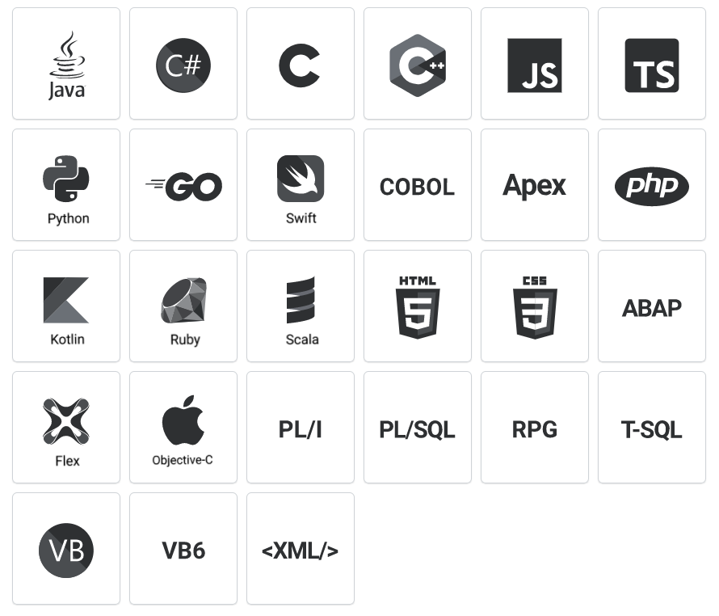
Wide Support
Multi-language
Your projects are multi-language.
So is SonarQube analysis.
Notes:
SonarQube support 27 languages, as the diagram listed.

Slide 12




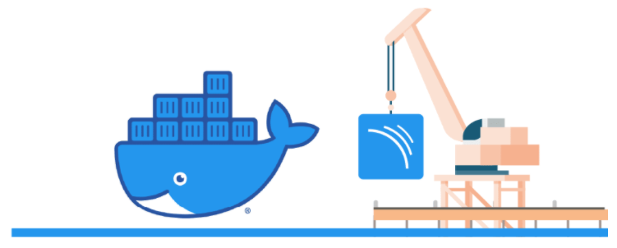

Wide Support
Minimal configuration required
PR-Analysis: analyze branches and decorate Pull Requests
CI engines
Build frameworks
WebAPI and Webhooks
IDE Plugin
Docker
Notes:
It also offers **wide tool support** so that **Minimal configuration are required.**

Slide 13
Wide Support
Integrate Other
Testing Tools
PMD-CPD
FindBugs
CheckStyle
PMD-P3C(alibaba)
Notes:
It can integrated testing tools, you can even define rules by yourself.

Slide 14

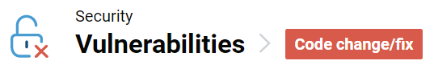
Security Analysis
Security issues should not be considered the de facto realm of security teams
Make development team deeply understand security issue and improve clean coding abilities.
Early security test and early fix.
Clear security issues, clear actions
Maximum protection with detection of injection flaws
Chase down the bad actors
Dedicated UI to track untrusted user input
More security feature at enterprise level
Notes:
And it has strong support for security analysis.

Slide 15
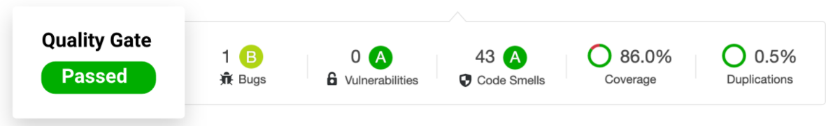
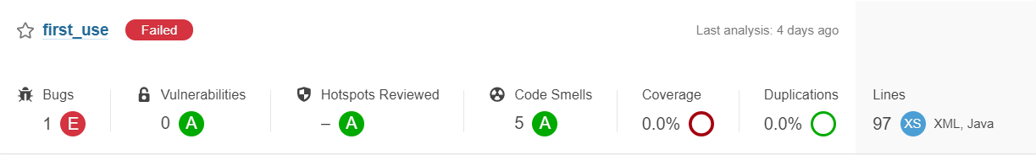
Quality Gate
Keep quality front and center throughout the development cycle
Notes:
About user interface, A clear Quality Gates show your project Releasability, clean and elegant.

Slide 16
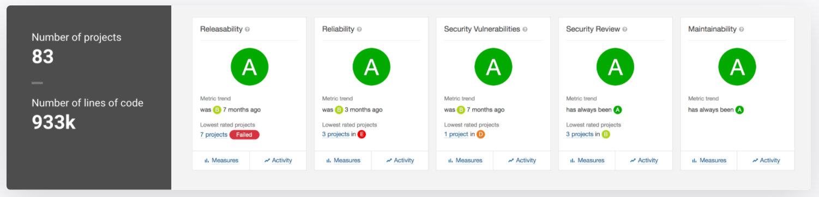
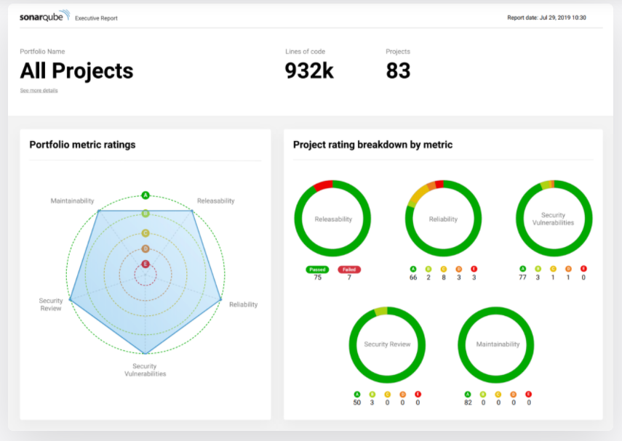
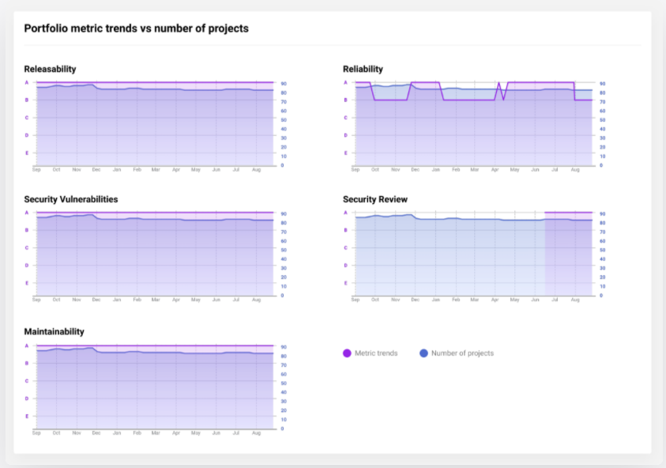
Team Management
Notes:
And You can manage all projects with different languages in the same place, and easy for teammates to cooperate.

Slide 17
4
Usage
How to use sonarqube?
Notes:
I will explain how to use sonarqube.

Slide 18

Workflow
SnoarQube is an on-promise static code analysis tool.
The steps to use it are:
Deploy SonarQube. Once the instance is up and running, Log in to http://localhost:9000 using System.
Create a new project and read in the project directory via scanner. (Maven and Gradle provide Sonar support, so you can install plugins directly. If other project management tools are used, SonarScanner need to be download).
After reading in the code, SonarQube will automatically perform code analysis and generate result reports.
Project
Sonar Scanner
Static Code Analysis
Notes:
Sonorqube is an on-promise analysis tool and you need to use the sonorscanner to scan your code into it.

Slide 19
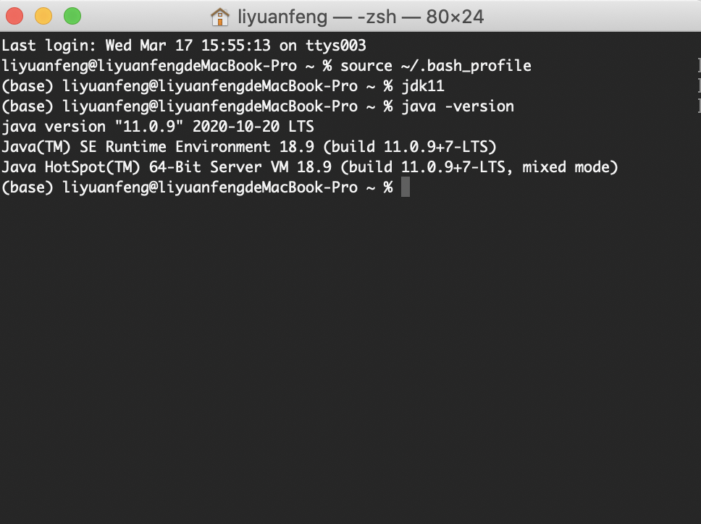
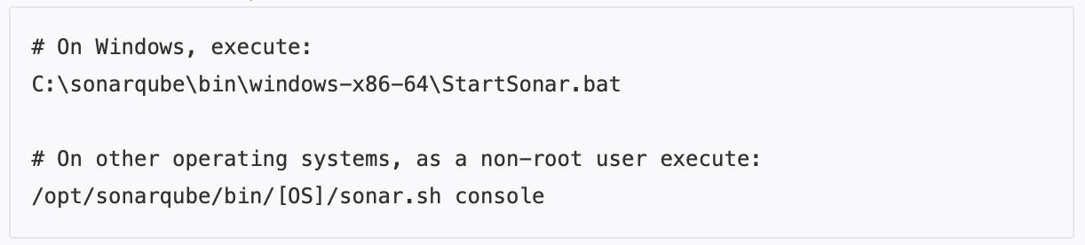
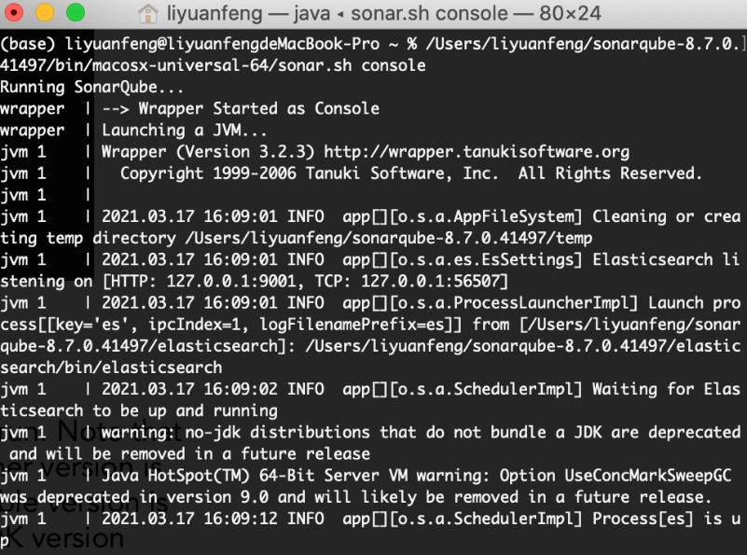
Configuration
:
输入你的标题
Configuring JDK11
SonarQube requires JDK11 environment to run. Note that sonarqube can only support JDK11, no other version is supported. If the current environment variable version is not 11, then you need to change the JDK version
Run Instance
Execute the above command from the console to start the local instance
Notes:
Sonorqube requires JDK version 11.(Note that only JDK11 is supported).So if you have other jdk versions, you may switch versions first. After configuring jdk, you can download the package and run the instance. The command is shown above. Then,onarqube can be accessed on localhost.

Slide 20
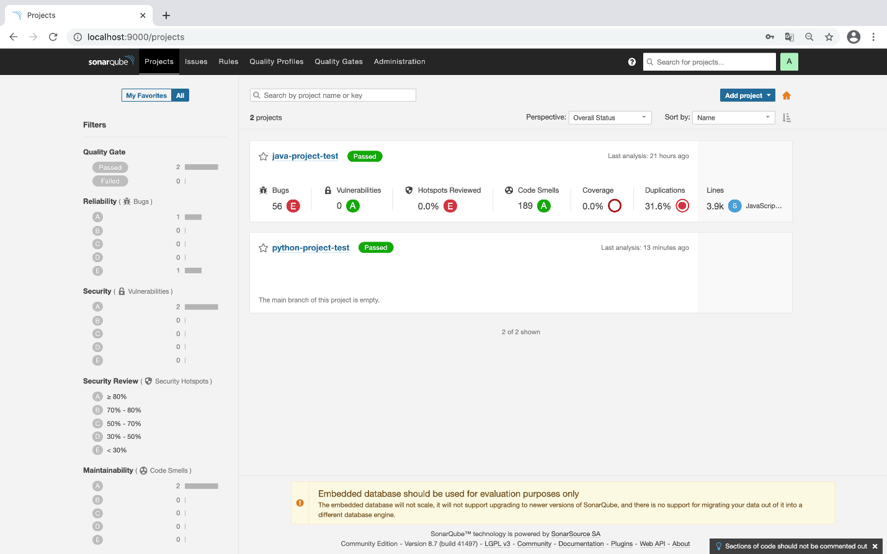
Configuration
:
输入你的标题
Main Interface
Once the local instance is deployed, you can access http://localhost:9000 and manage the project analysis results in the main interface after completing the login.
Notes:
Here is the main user interface of sonarqube.

Slide 21
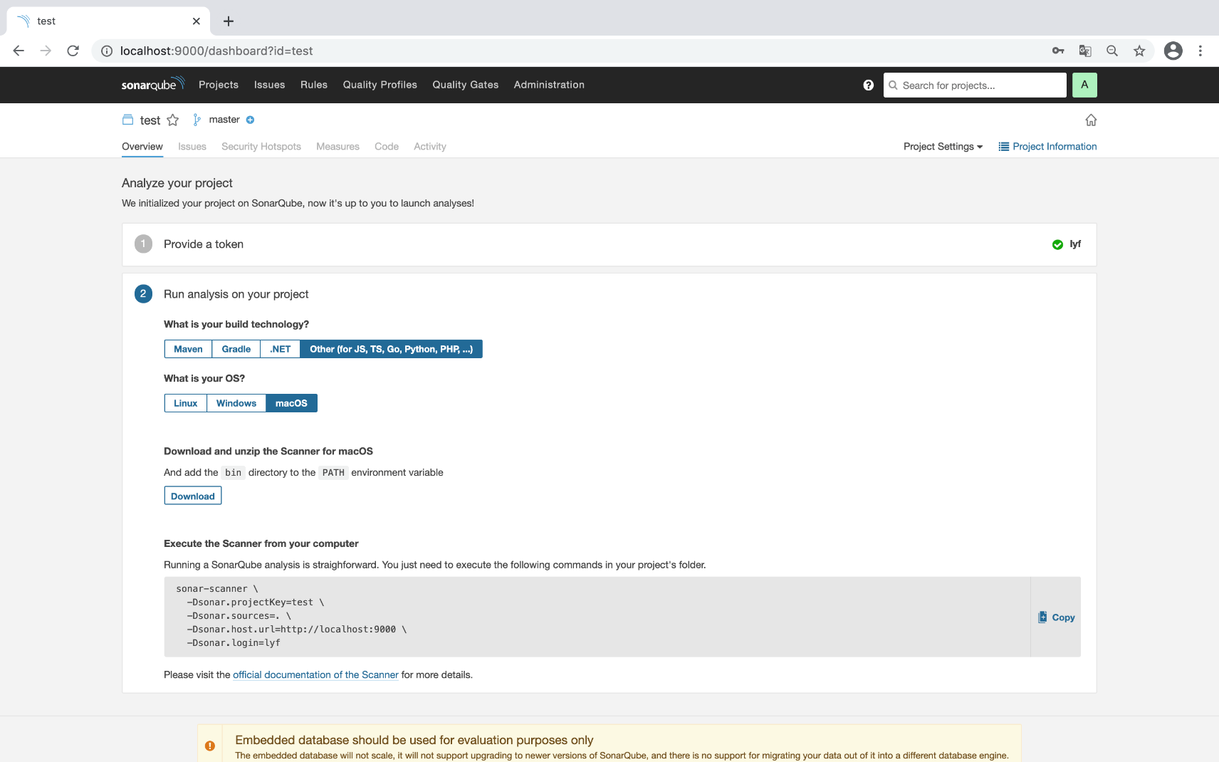
Add project: Use SonarScanner
:
Click Add Project in the main screen to create a new project. After setting the project name and token, you can use SnoarScanner to scan the project. Note that if you are already using Maven or Gradle as scanning tools, you can directly download the built-in plug-in to complete the sonar support.
输入你的标题
Get SnoarScanner: http://localhost:9000/documentation/analysis/scan/sonarscanner/
Notes:
And then, you need to get the sonarscanner to scan your code into sonarqube. Please refer to the official documentation to get sonarscanner.

Slide 22
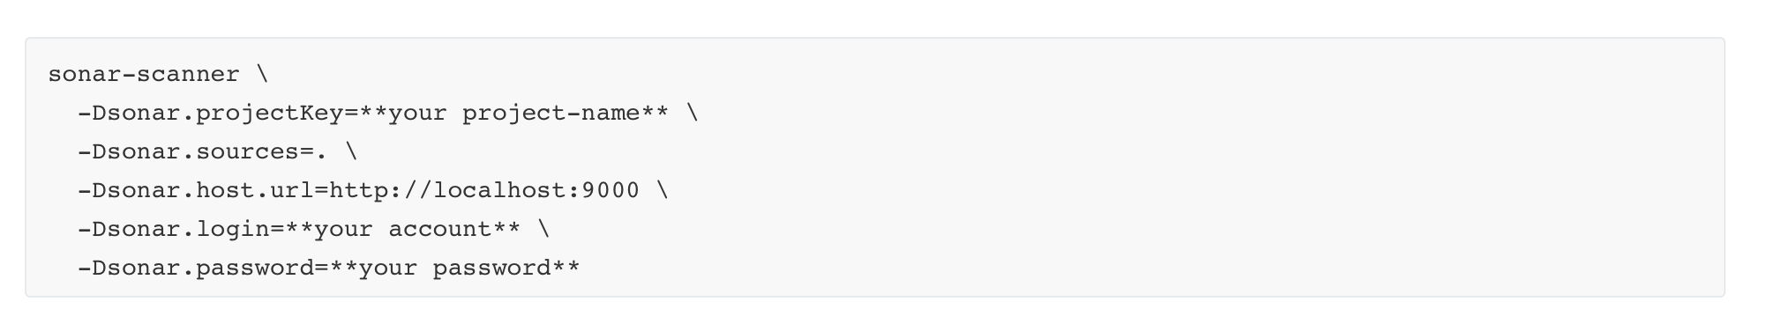
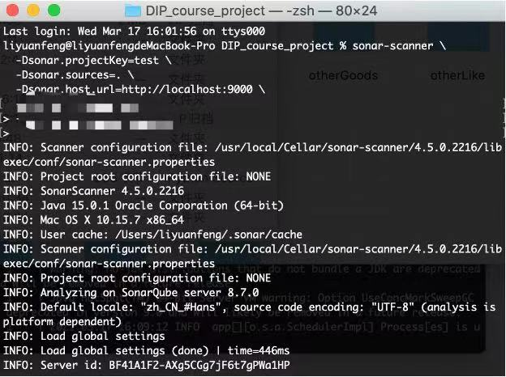
Add project: Use SonarScanner
Once the configuration of SonarScanner is completed, enter the path of the project you want to analyze in the console and enter the above command to complete the code scan. Once the scan is complete, you can see the results of the static code analysis in the main interface.
输入你的标题
Notes:
Once you finished configuring sonarscanner, run the command to scan your project and get a result.

Slide 23
5
Functionalities
Your teammate for Code Quality and Code Security
Notes:
So the point is, how about the result?

Slide 24

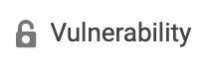




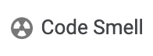
Analysis Dimension
Application Security
Fix vulnerabilities that compromise your app, and learn AppSec along the way with Security Hotspots.
Code Quality
Technical Advance
Catch existing tricky bugs or to prevent undefined behavior from impacting end-users.
Ensure the maintainability and readability of code. Increase developer velocity and efficiency.
Notes:
Sonarqube will analysis code In three dimensions and four rules. First, code quality, that is to say, finding bugs. Second, security. Sonorqube will help you fix the vulnerabilities and latent security problems. Third, snoarqube will focus on technical advance, which is about code smell. In orther words，even if your code are not wrong, sonarqube will reinforce its quality(iwhich means, maintainability or readability).

Slide 25
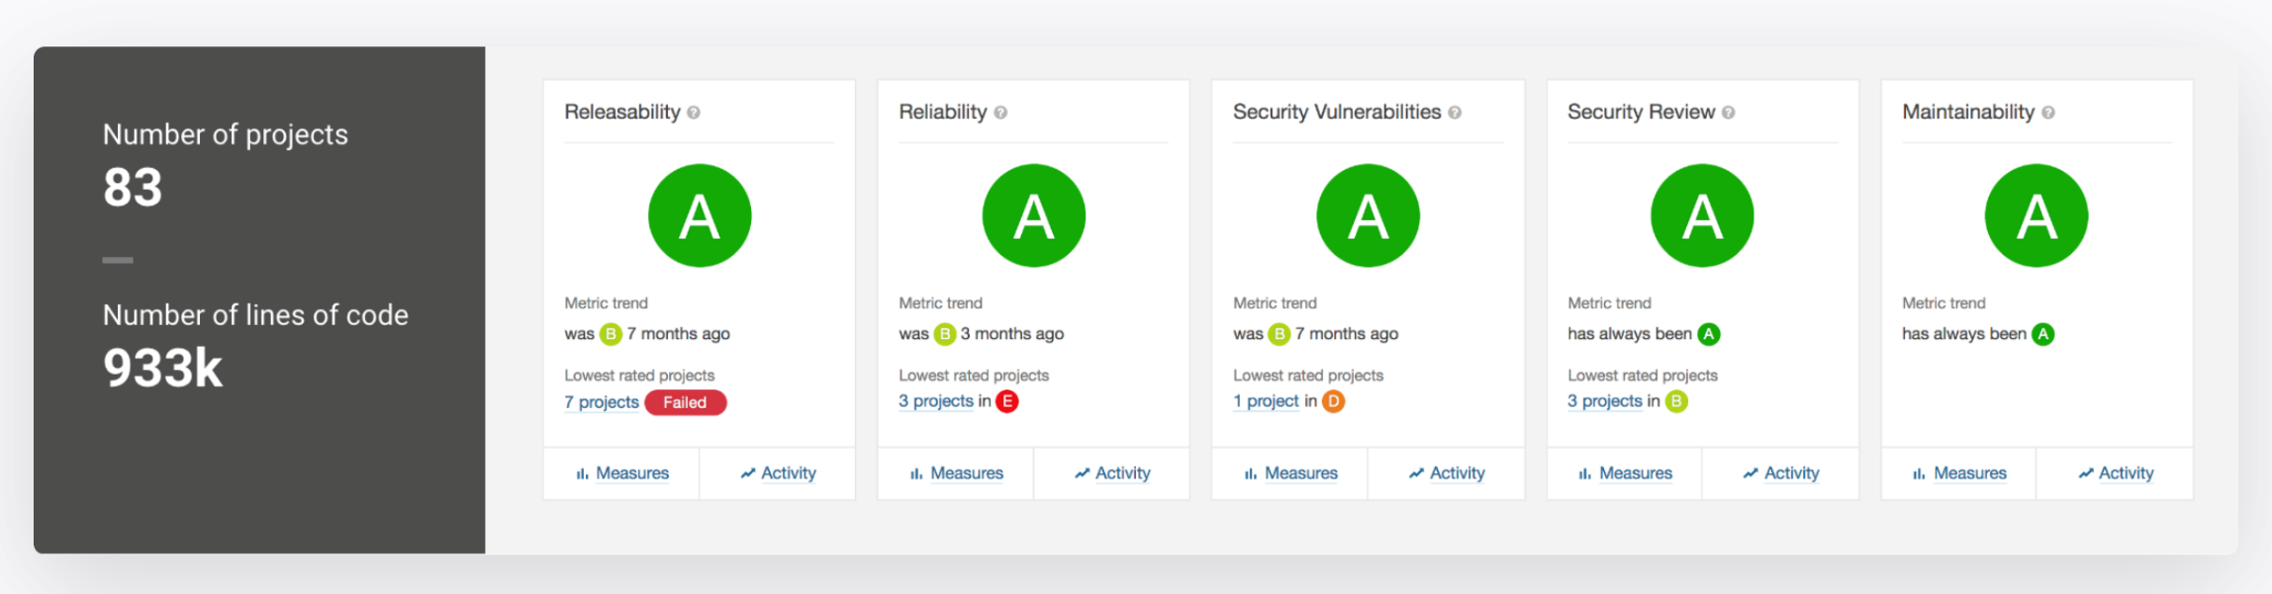


Result
A Comprehensive And Visual Report
SonarQube sets a Quality Gate during evaluation, i.e. the quality of the code needs to meet certain criteria to be in state, otherwise it will be in state. For code that has passed, SonarQube can quickly assign a score A~E based on the quality of the code, which allows the code to be quickly and intuitively evaluated in multiple dimensions.
Notes:
The result will be presented as a comprehensive and visual report, which includes ratings in different rules and a general rating of the project. You can also chec the detail of issues. And since we have tried it, the result examples will be shown in our experiments.

Slide 26
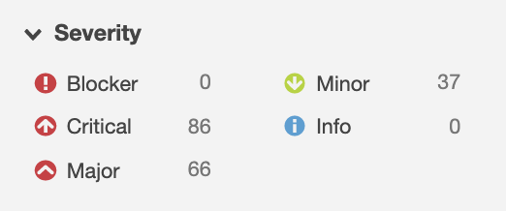
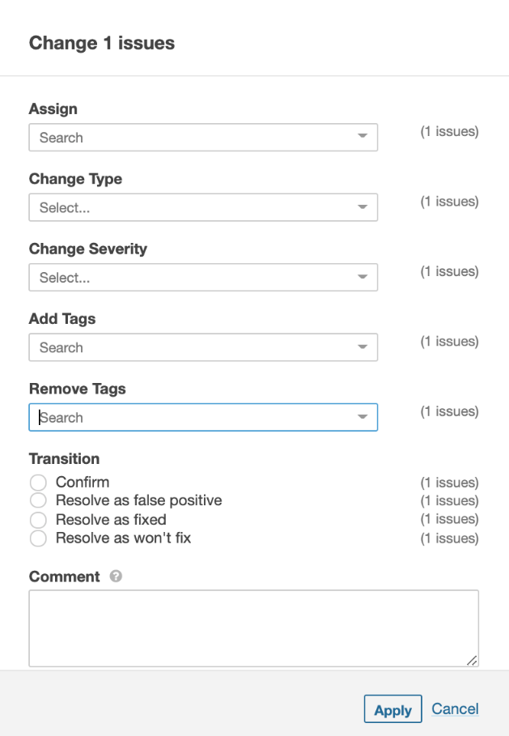
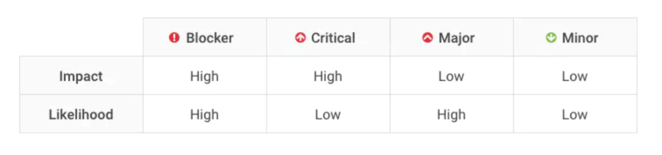
Issue Management
Issue Grading
In order to have a valid metric for the issues, SonarQube graded all issues into 4 levels.
Impact: Will the "worst thing" take down the application (either immediately or eventually), or corrupt stored data? If the answer is "yes", impact is high.
Likelihood: What is the probability the worst will happen?
Manage the issue by yourself
Developers can change the level and priority of issues themselves, and can also attach some comments for better handling of issues.
Notes:
In every rules, sonarqube grades the issue according to its impact and likelihood. The impact means the influence when worst things happens, while the likelihood means the probability the worst thing will happen. For sure, You can also adjust the severity of the problem by yourself. We have repeated four rules for many times，and then we will specifically explain each rule.

Slide 27
Rules: Bug
What is bug?
Bug Types
A software bug is an error, flaw or fault in a computer program or system that causes it to produce an incorrect or unexpected result, or to behave in unintended ways.
Most bugs arise from mistakes and errors made in either a program's design or its source code, or in components and operating systems used by such programs. A few are caused by compilers producing incorrect code.
Arithmetic
Logic
Resource
Syntax
Multi-threading
输入你的标题
Interfacing
Teamworking
For common bugs, view: https://cwe.mitre.org/data/definitions/699.html
Notes:
SonarQube Covered most of the bug types.

Slide 28


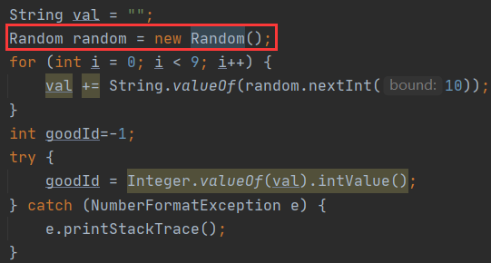
Example: Save and re-use this "Random".
Problem:
1. inefficient
2. may be not random depending on the JDK.
Solution:
Save and re-use this “Random”.
Notes:
For example, It’s critical not to create Random object each time, since some JDK may use the same seed every time and produce number not random.

Slide 29
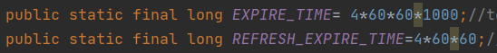
Example: Cast one of the operands of this multiplication operation to a "long".
Problem:
if the result of multiplication is assigned to a long, it may have already overflowed before the assignment.
Solution:
at least one operand should be cast or promoted to the final type before the operation takes place.

Slide 30

Rules: Vulnerability
What is vulnerability?
Lack of input validation on user input
A vulnerability is a hole or a weakness in the application, which can be a design flaw or an implementation bug, that allows an attacker to cause harm to the stakeholders of an application. Stakeholders include the application owner, application users, and other entities that rely on the application.
Lack of sufficient logging mechanism
输入你的标题
Fail-open error handling
For common vunlnerability, view: https://owasp.org/www-community/vulnerabilities/
Notes:
OK,First,let’s see the vulnerability
What is vulnerability?the explanation from the owasp tells us that A vulnerability is a hole or a weakness in the application, which can be a design flaw or an implementation bug, that allows an attacker to cause harm to the stakeholders of an application.
For example the loaf the input validation on user input.

Slide 31
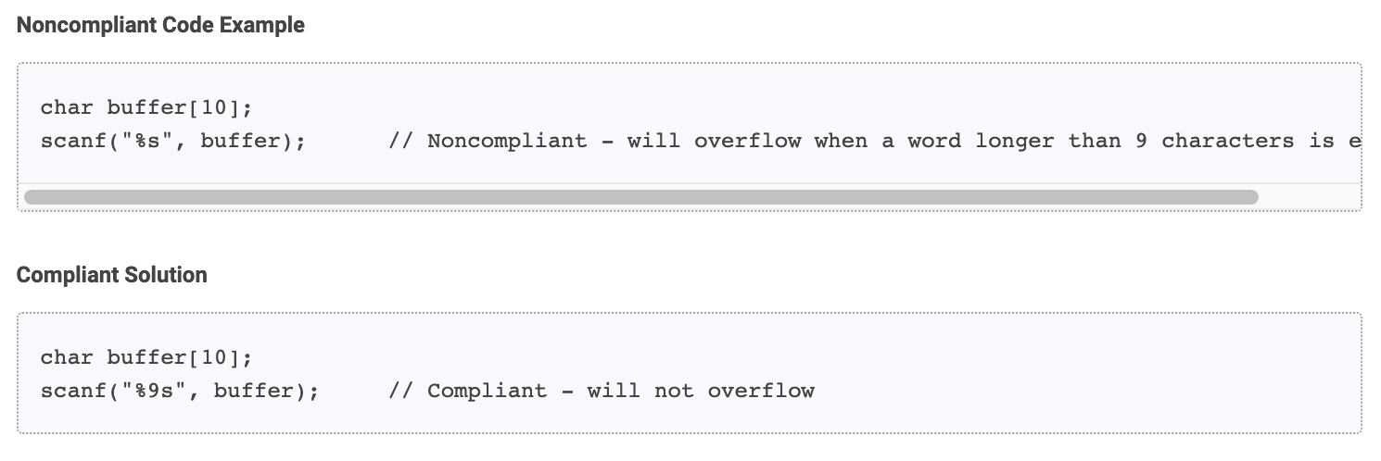
Examples: "scanf()" and "fscanf()" format strings should specify a field width for the "%s" string placeholder
The %s placeholder is used to read a word into a string.
By default, there is no restriction on the length of that word, and the developer is required to pass a sufficiently large buffer for storing it.
No matter how large the buffer is, there will always be a longer word.
Therefore, programs relying on %s are vulnerable to buffer overflows.
A field width specifier can be used together with the %s placeholder to limit the number of bytes which will by written to the buffer.
Note that an additional byte is required to store the null terminator.
Notes:
OK,lets see an example. Examples: “scanf()” and “fscanf()” format strings should specify a field width for the “%s” string placeholder。By default, there is no restriction on the length of that word, and the developer is required to pass a sufficiently large buffer for storing it. But No matter how large the buffer is, there will always be a longer word.
The Noncompliant code example here shows us the scanf without the field width specifier.so it will overfow when a word longer than 9 characters entered. And the compliant solution below will not overflow.

Slide 32
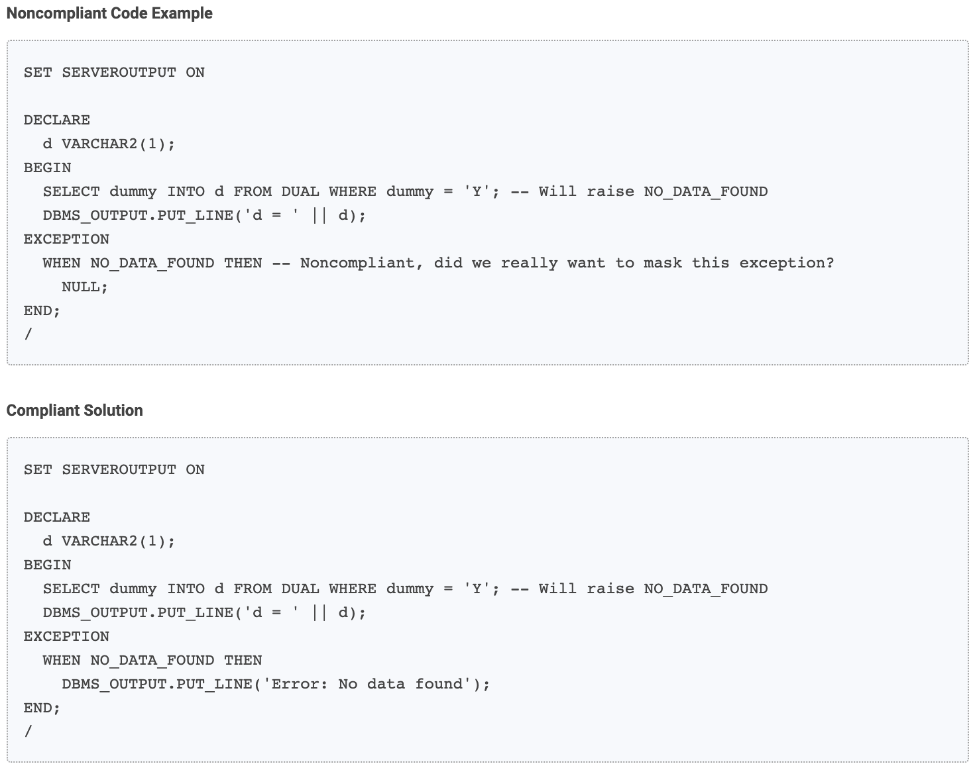
Examples: Exceptions should not be ignored.
When exceptions occur, it is usually a bad idea to simply ignore them. Instead, it is better to handle them properly, or at least to log them.
Notes:
The second example shows us that in SQL, exceptions should not be ignored.
When exceptions occur, it is usually a bad idea to simply ignore them. Instead, it is better to handle them properly, or at least to log them.
In the Noncompliant code we can see that when there is no data found we did nothing, while in the compliant solution we output the error message to tells us what exactly the error is .

Slide 33
Rules: Security Hotspot
What is security hotspot?
Resolve as Reviewed
Unlike Vulnerabilities, Security Hotspots aren't necessarily issues that are open to attack. Instead, Security Hotspots highlight security-sensitive pieces of code that need to be manually reviewed. Upon review, you'll either find a Vulnerability that needs to be fixed or that there is no threat.
Set as In Review
输入你的标题
Reset as To Review
Open as Vulnerability
Notes:
Then what is security hotspot?
Unlike Vulnerabilities, Security Hotspots aren't necessarily issues that are open to attack. Instead, Security Hotspots highlight security-sensitive pieces of code that need to be manually reviewed.
You can perform the following actions on Security Hotspots:
Resolve as Reviewed
Set as In Review
Reset as To Review
Open as Vulnerability

Slide 34
Examples: Using clear-text protocols is security-sensitive
Ask Yourself Whether
The confidentiality and integrity of data is necessary in the context of the web application.
The data is exchanged on an exposed network (Internet, public network etc). There is a risk if you answered yes to any of those questions.
Clear-text protocols as ftp, telnet or non secure http are lacking encryption of transported data. They are also missing the capability to build an authenticated connection. This mean that any attacker who can sniff traffic from the network can read, modify or corrupt the transported content.
Recommended Secure Coding Practices
Use ssh as an alternative to telnet
Use sftp, scp or ftps instead of ftp
Use https instead of http
Use SMTP over SSL/TLS or SMTP with STARTTLS instead of clear-text SMTP
It is recommended to secure all transport channels (event local network) as it can take a single non secure connection to compromise an entire application or system.
Notes:
First example comes to using clear text protocols is security-sensitive
The sonar qube recommend us to use ssh \sftp and etc to secure all transport channels (event local network) as it can take a single non secure connection to compromise an entire application or system.

Slide 35
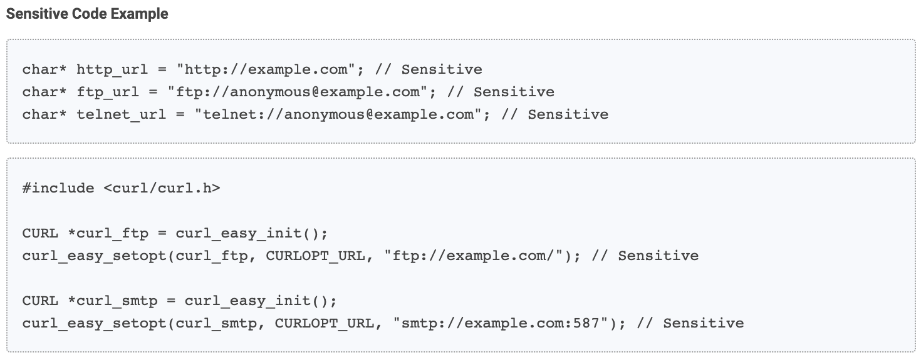
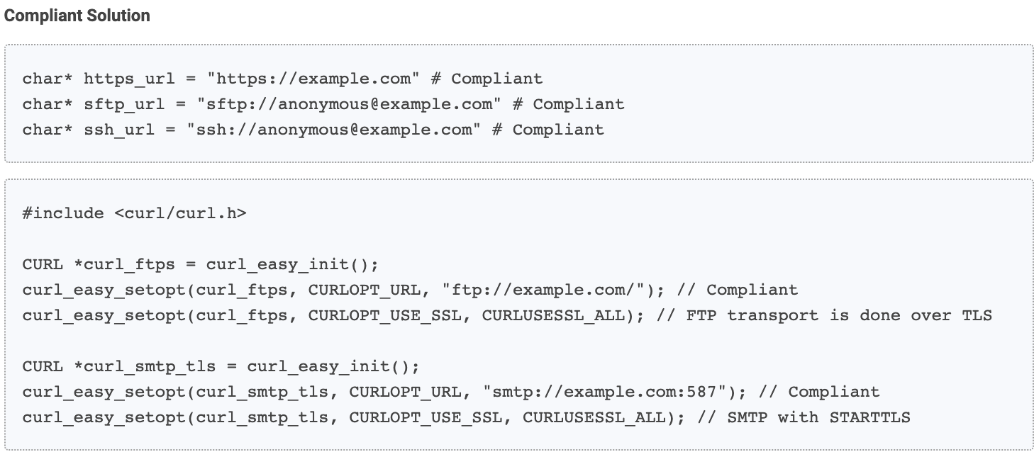
Examples: Using clear-text protocols is security-sensitive
Notes:
The first example show to Using clear-text protocols is security-sensitive
It is used in c plus plus.
In the sensitive code we use the http,ftp,and telent url and the clear-text SMTP
While we use the https,sftp and ssh to replace them. Also we use the FTP over TLS and SMTP with STARTTLS to make our code more complaint

Slide 36
Examples: Using pseudorandom number generators (PRNGs) is security-sensitive.
Ask Yourself Whether
the code using the generated value requires it to be unpredictable. It is the case for all encryption mechanisms or when a secret value, such as a password, is hashed.
the function you use generates a value which can be predicted (pseudo-random).
the generated value is used multiple times.
an attacker can access the generated value.
When software generates predictable values in a context requiring unpredictability, it may be possible for an attacker to guess the next value that will be generated, and use this guess to impersonate another user or access sensitive information.
As the functions rely on a pseudorandom number generator, they should not be used for security-critical applications or for protecting sensitive data.
Recommended Secure Coding Practices
Use functions which rely on a strong random number generator such as randombytes_uniform() or randombytes_buf() from libsodium, or randomize() from Botan.
Use the generated random values only once.
You should not expose the generated random value. If you have to store it, make sure that the database or file is secure.
Notes:
Lastly,we can see Using pseudorandom number generators (PRNGs) is security-sensitive.
It is also used in c plus plus.
When software generates predictable values in a context requiring unpredictability, it may be possible for an attacker to guess the next value that will be generated, and use this guess to impersonate another user or access sensitive information.
It recommend us to use functions which rely on a strong random number generator such as randombytes_uniform() and ect.
And use the values only once.

Slide 37
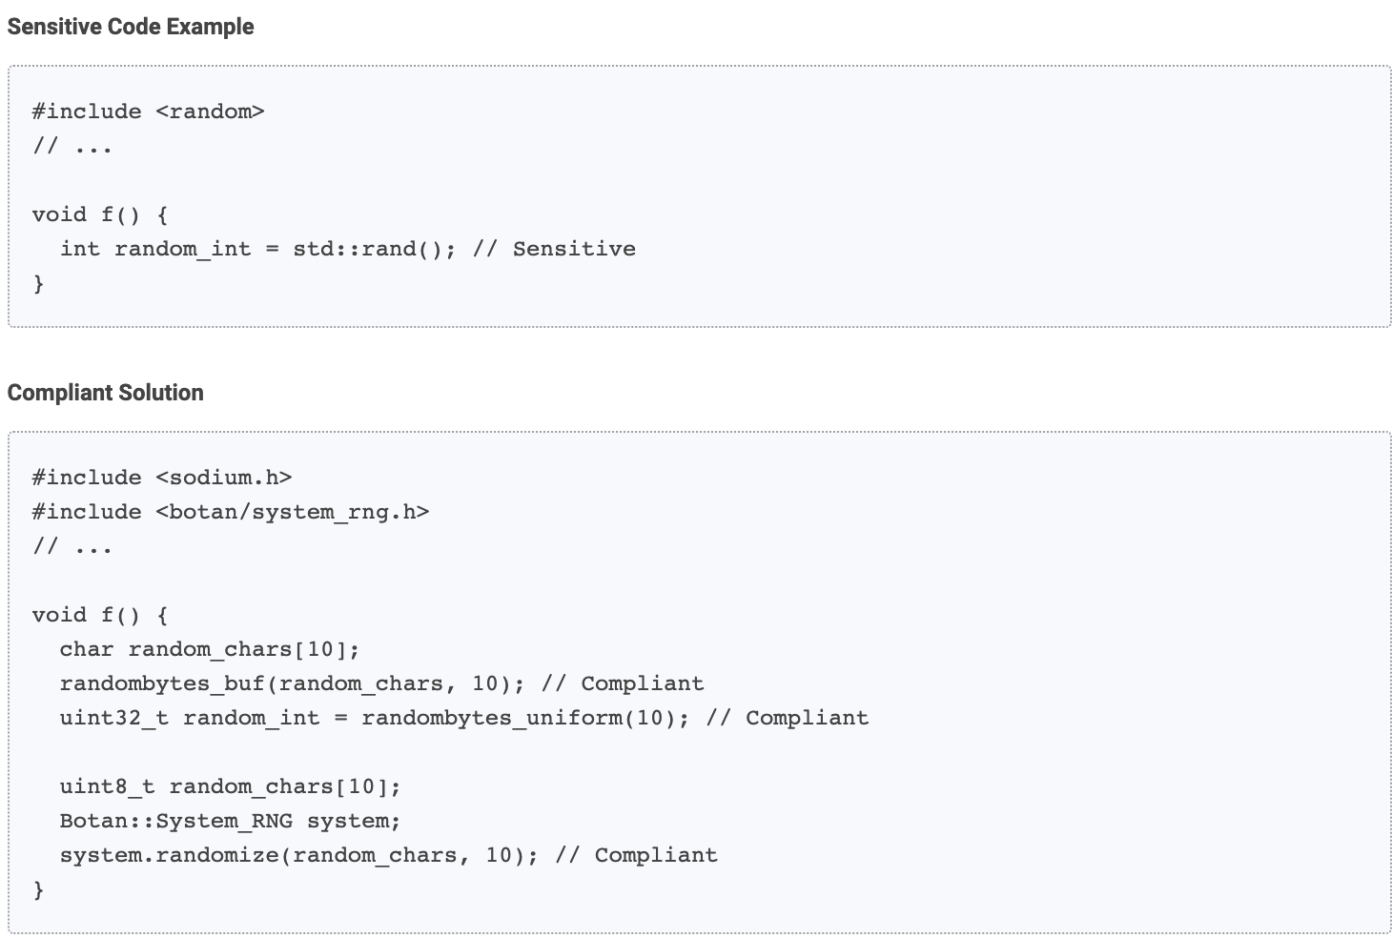
Examples: Using pseudorandom number generators (PRNGs) is security-sensitive.
Notes:
Let‘s see an example.we use the function randombytes_uniform() or randombytes_buf() from libsodium, or randomize() to instead of rand().

Slide 38


Rules: Code Smell
What is code smell?
Application-level
Code smells are usually not bugs; they are not technically incorrect and do not prevent the program from functioning. Instead, they indicate weaknesses in design that may slow down development or increase the risk of bugs or failures in the future. Bad code smells can be an indicator of factors that contribute to technical debt.
It is closely related to code readability and maintainability
Mysterious Name
Duplicated code
Contrived complexity
…
Class-level
Large class
Feature envy
Inappropriate intimacy
Lazy class/freeloader
…
Method-level
输入你的标题
Too many parameters
Long method
Excessively long identifiers
Excessive return of data
…
For common code smells, view: https://en.wikipedia.org/wiki/Code_smell
Notes:
Code smell is directly related to technical debts. As we can see, code smell is not bugs, rather a ‘poor design’. Removing code smell can substantially improve our project quality and design level.

Slide 39
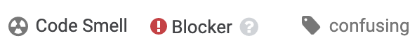

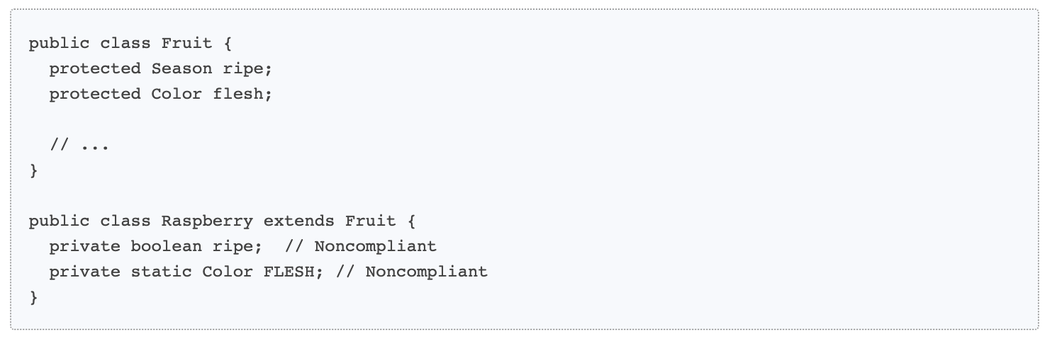
Examples: Child class fields should not shadow parent class fields
By
Having a variable with the same name in two unrelated classes is fine, but do the same thing within a class hierarchy and you'll get confusion at best, chaos at worst.
:
Noncompliant Code Example
输入你的标题
Notes:
Here are 2 code smell examples. First is simple and common: you are not suggested to use the same name within a class hierarchy(except static or private). Although it’s not wrong, it may render your code at a chaos. And this code smell can be detected by most of IDE.

Slide 40
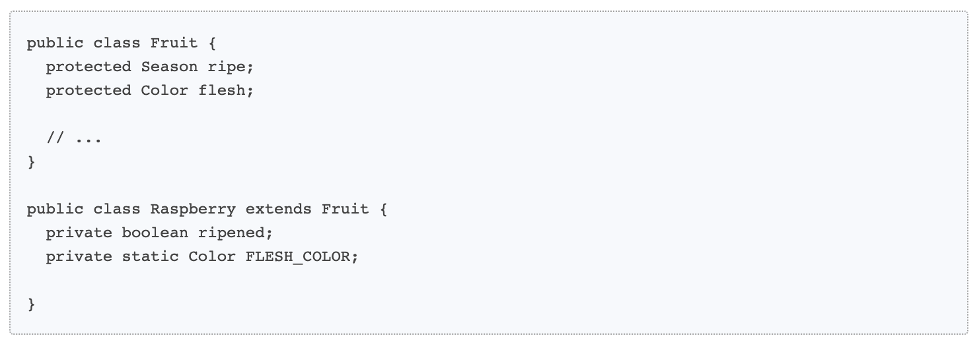
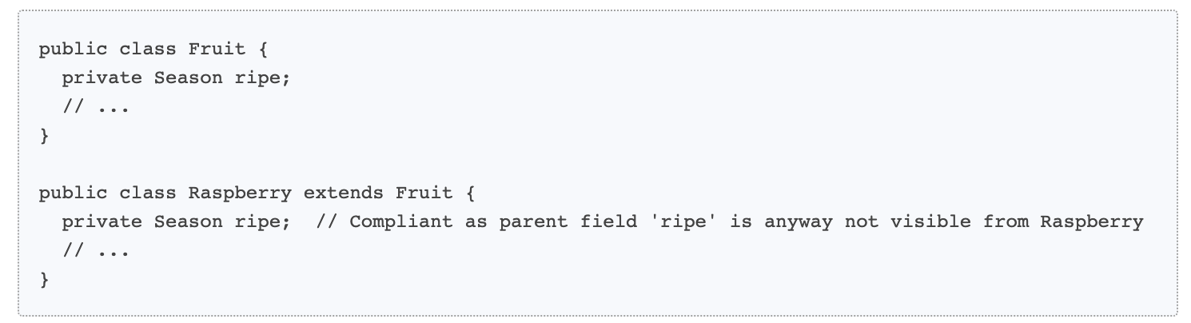
Examples: Child class fields should not shadow parent class fields
Compliant Solution
输入你的标题
Exceptions
This rule ignores same-name fields that are static in both the parent and child classes.
This rule also ignores private parent class fields, but in all other such cases, the child class field should be renamed.

Slide 41
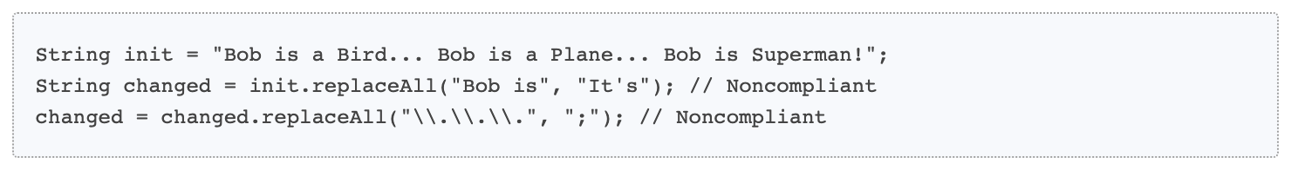
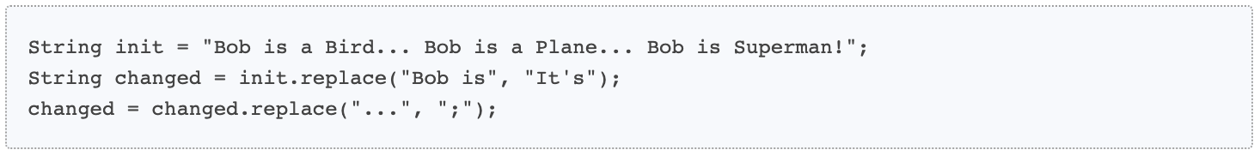
Examples: "String#replace" should be preferred to "String#replaceAll"
By
:
The underlying implementation of String::replaceAll calls the java.util.regex.Pattern.compile() method each time it is called even if the first argument is not a regex. This has a significant performance cost and therefore should be used with care.
When String::replaceAll is used, the first argument should be a real regex. If it’s not the case, String::replace does exactly the same thing as String::replaceAll without the performance drawback of the regex.
This rule raises an issue for each String::replaceAll used with a String as first parameter which doesn’t contains special regex character or pattern.
Noncompliant Code Example
Compliant Solution
输入你的标题
Notes:
The second one is more refined and specific. There are 2 methods in java, replaceall() and replace(). They are both used to replace the specified character in one string.But replaceall() allow both regex and string as first parameter while replace() receives only string. So if one use string as first parameter for replace all(), the method will spend time judge wether it is a regex. Under such circumstance, sonarqube will recommend using replace() to save time. Such improvement seems subtle, but Even small time savings can be critical for a large-scale project.

Slide 42
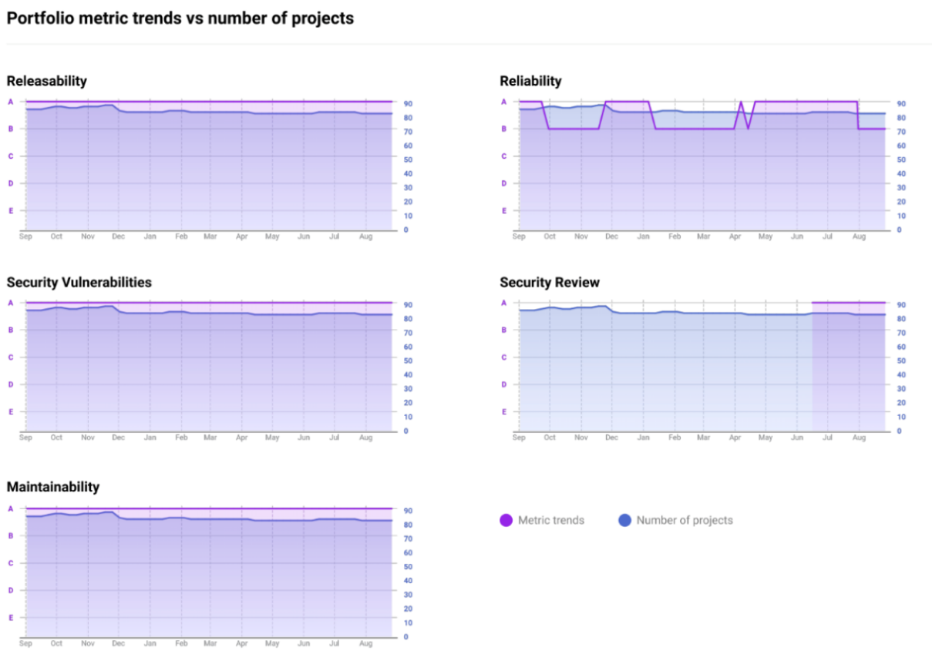
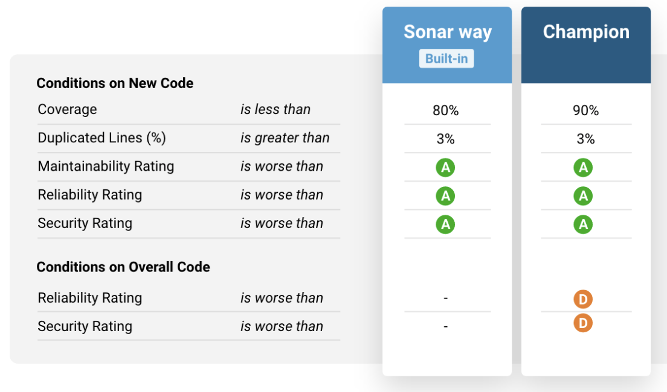

Other Services
Corporation Support
Set a submission threshold for teams, or set up a "Champions’ League" and watch developers vie to join it.
PDF Report Service
Subscribe to regular delivery of concise, actionable PDF reports.
Notes:
There are other advanced functionalities in sonarqube, such as corporation support or getting a PDF report. Due to the limited time, we will not explain them specifically.

Slide 43
6
Experiments
Our Trials

Slide 44
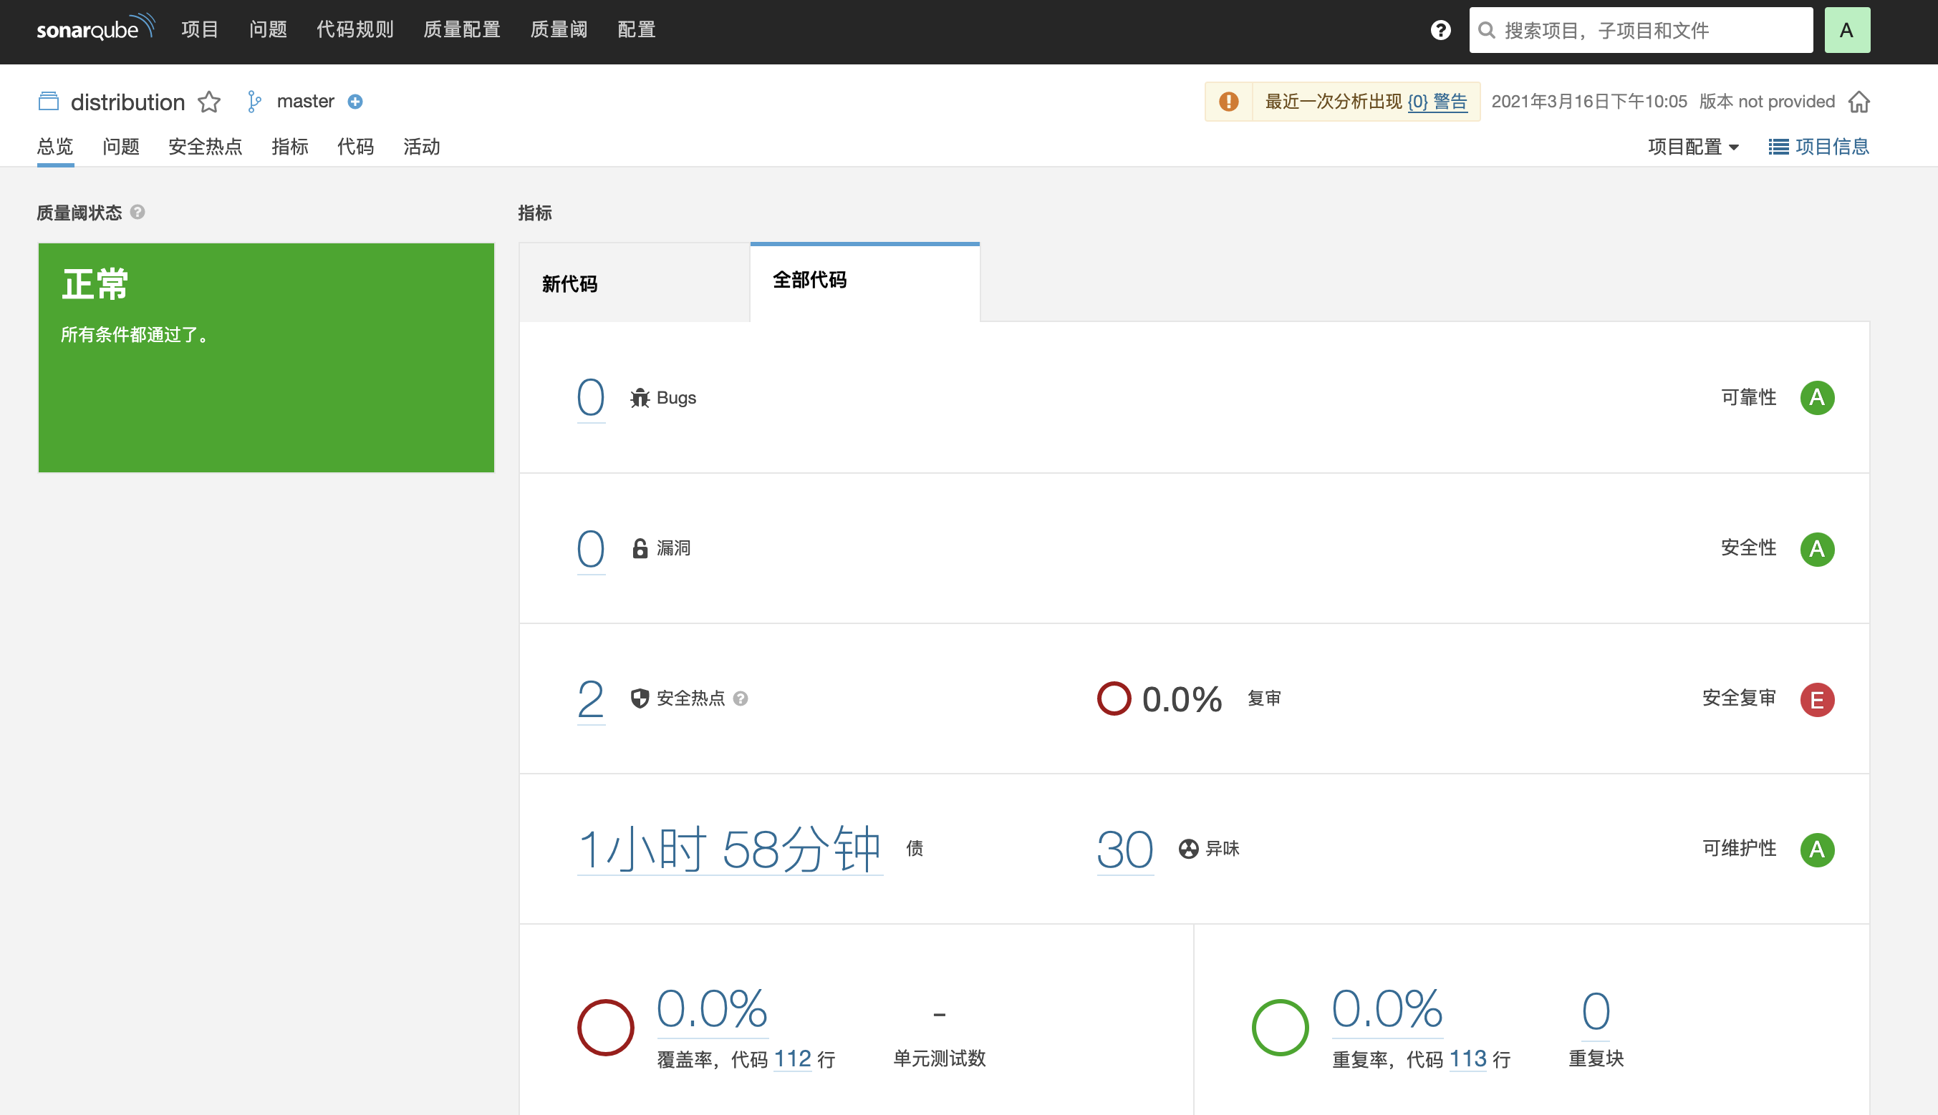
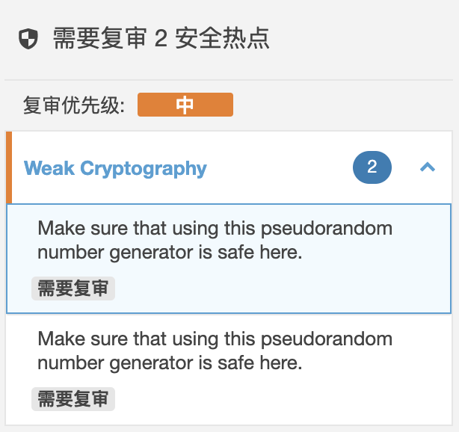
Python PROJECT: Distributed group membership service
:
输入你的标题
Analysis Result
The reason for the security hotspot here is that we use the function random here, and SonarQube is security-sensitive to it .
Notes:
The sonarQube can shows in Chinese if you install the language package.
I run the sonarQube under my python project,it is used to show the distributed group membership service.
As we can see , there are 2 security hotspot and 30 code smell here.
Here is one of the security hotspot:
The reason for the security hotspot here is that we use the function random here, and SonarQube is security-sensitive to it .

Slide 45
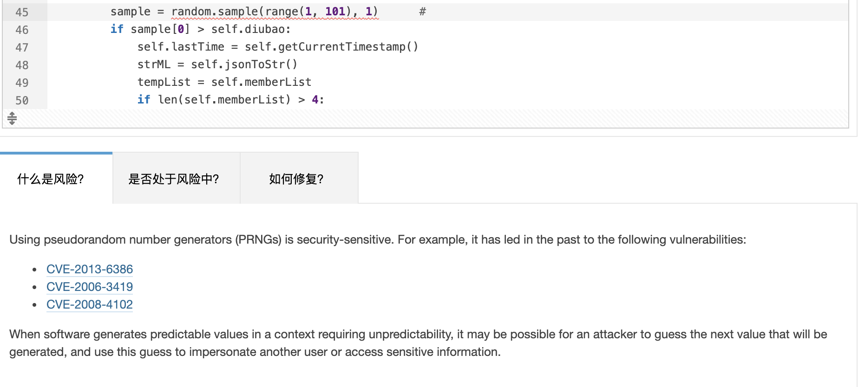
Python PROJECT: Distributed group membership service
:
输入你的标题
Detail of an issue
For each issue, we can look at its corresponding location in the code and make changes to it. SonarQube tells us what is the risk, gives reasons why we need to make such changes and shows us how to fix it.
Notes:
And in Sonarqube For each issue, we can look at its corresponding location in the code and make changes to it. SonarQube tells us what is the risk, gives reasons why we need to make such changes and shows us how to fix it.

Slide 46
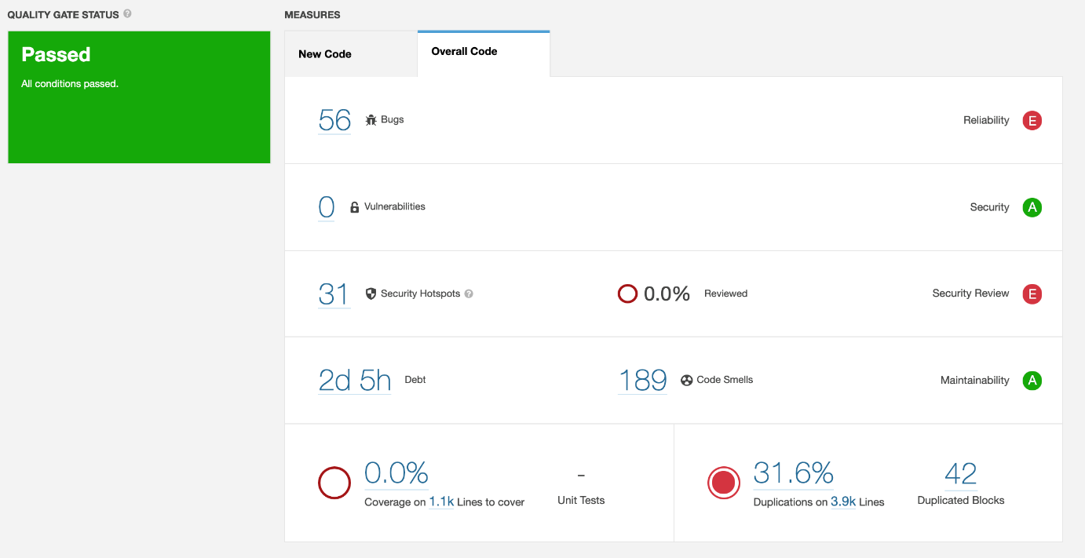
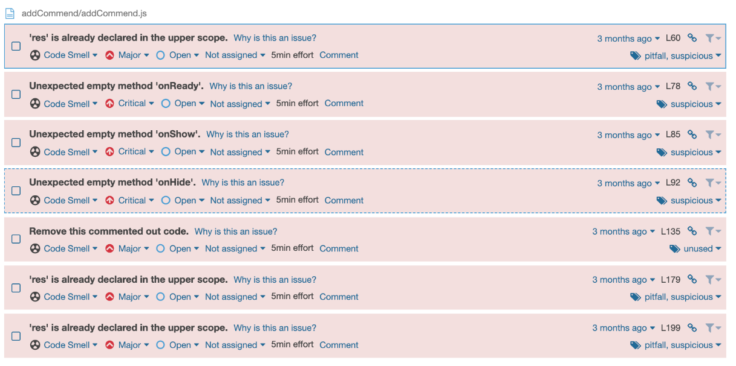
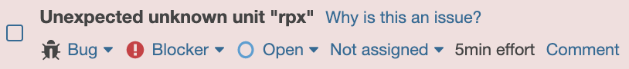
HTML-CSS-JS PROJECT: A second-hand goods trading WeChat applet（Software Engineering)
:
输入你的标题
Analysis Result
The reason for the bug here is that we use rpx units, which are only supported by the WeChat applet IDE, and sonarqube does not recognize rpx units.
Notes:
We also use sonorqube to analysis our software engineering project, a wechat applet. Note that there are bugs, because sonarqube does not support the ‘rpx’unit which is covenient for cell-phone screen measurement and only supported by wechat applet IDE.

Slide 47
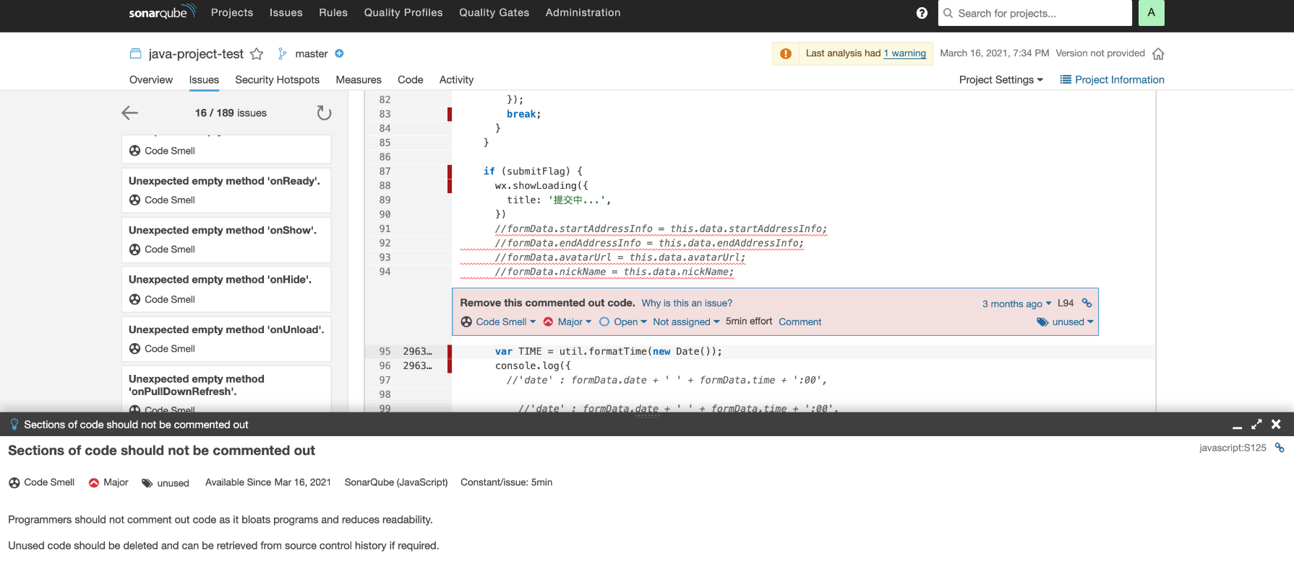
HTML-CSS-JS PROjECT: A second-hand goods trading WeChat applet（Software Engineering)
:
输入你的标题
Detail of an issue
For each issue, we can look at its corresponding location in the code and make changes to it. SonarQube also gives reasons why we need to make such changes.
There are a lot of empty functions, unused variables, renamed variables and invalid code comments in our code.
Notes:
Sonarqube successfully detected 189 code smells in our project. Including empty functions , unused variables, renamed variables ,invalid code comments and so on. For each issue, we can look at its corresponding location in the code and make changes to it. SonarQube also gives us detailed reasons why we need to make such changes.

Slide 48


Thanks

